Slide 1
Restaurant Attribute Extraction
Team 8
Amparo Canaveras
Zhi Li
Cheng Qi
Ana Pena
Yujie Zhong
Notes:
Click to add notes

Slide 2
Introduction
Project Description
A python implementation that can extract all the attributes discussed in a given customer review.
Scraping 30000+ reviews from Japanese, Indian and American restaurant in Chicago from the yelp
Extracting attributes and analyzing for each review
Outputs / Results
If the review is "I went there last night. Great service and good food. However, the location is bad", the output will be (service, food, location)
Notes:
How presentation will benefit audience: Adult learners are more interested in a subject if they know how or why it is important to them.
Presenter’s level of expertise in the subject: Briefly state your credentials in this area, or explain why participants should listen to you.

Slide 3
Implementation
Python Code was deployed to perform the following actions:
Web Scraping
Collected 30000+ reviews from Japanese, Indian and American restaurant in Yelp.
Attribute Extraction
Extracted attributes for each review generated
Attribute Analysis
Grouped attributes analyzed different attribute/frequency in the three types of restaurants
Notes:
Lesson descriptions should be brief.

Slide 4
Web scraping - Code
These were the functions implemented in python in order to collect the reviews from Yelp:
Part1: Getting links:
run_japan() – Collect the link of each Japanese restaurant in Chicago from Yelp website result and finally output the result into the txt files.
run_indian() – Collect the link of each Indian restaurant in Chicago from Yelp website result and finally output the result into the txt files.
run_usa() – Collect the link of each American restaurant in Chicago from Yelp website result and finally output the result into the txt files.
getLink() - Retrieves and Adjective followed by a Noun. E.g good food
Notes:
Example objectives
At the end of this lesson, you will be able to:
Save files to the team Web server.
Move files to different locations on the team Web server.
Share files on the team Web server.

Slide 5
Web scraping - Code
These were the functions implemented in python in order to collect the reviews from Yelp:
Part2: Getting reviews:
get_link_list() – Read the file to get and return the links of each restaurant.
get_review_rating() – Get the content of review and rating from the given tag and return them.
jp_get_tags() – Collect the reviews of 11 pages of each Japanese restaurant in Chicago on Yelp website result and finally output the result into the txt files.
in_get_tags() – Collect the reviews of 11 pages of each Indian restaurant in Chicago on Yelp website result and finally output the result into the txt files.
usa_get_tags() – Collect the reviews of 11 pages of each American restaurant in Chicago on Yelp website result and finally output the result into the txt files.
Notes:
Example objectives
At the end of this lesson, you will be able to:
Save files to the team Web server.
Move files to different locations on the team Web server.
Share files on the team Web server.

Slide 6
Attribute Extraction - Code
These were the functions implemented in python in order to retrieve the Attributes from the reviews obtained in the Scraping phase:
get_reviews – Retrieves reviews from the web scraping generated files
get_attributes - Retrieves the POS tags for all the words in any given review
getAdjNoun() - Retrieves and Adjective followed by a Noun. E.g good food
getAdjNounAnyNoun - Retrieves and Adjective followed by two Nouns. Eg. Good food and Wine
getNounVerbAdj – Retrieves a noun followed by a Verb and an Adjective. E.g. food was good
getNounVerbAdvAdj - Retrieves a noun followed by a Verb an Adverb and Adjective. E.g. food was really bad

Slide 7
Attribute Extraction - Code
clean, clean_uselesswords() - These two functions clean the reviews from words that are irrelevant such as Determinant, Conjunctions, Particles, Pronouns and other non specific words.
process_sentence - Retrieves attributes for one review
process_file - Retrieves attributes for all the review in a file with the format as you left in the directory. It also creates a dictionary with every attribute an the number of times it appear for all the reviews in the file

Slide 8
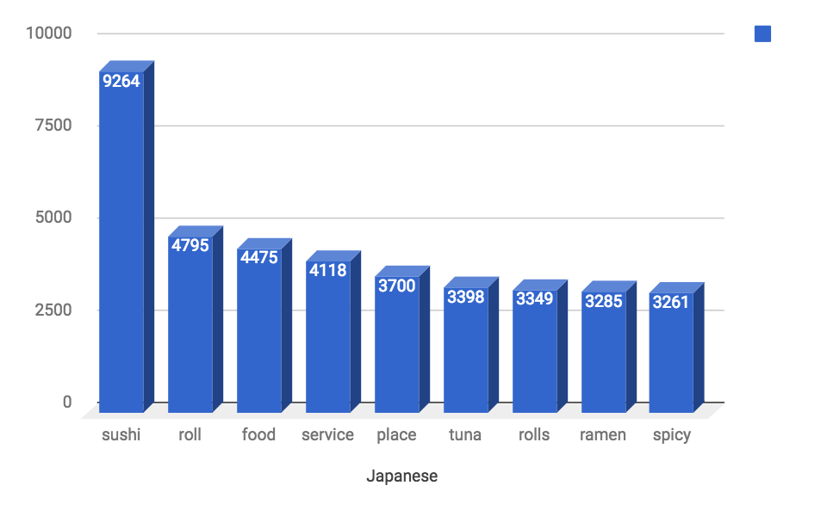
Analysis and Conclusions
Top 9 attributes in three types of restaurants are selected for comparison and analysis
Restaurant | The 9 most frequent attributes in reviews from Yelp
Indian | Food | Chicken | Service | Naan | Indian | Place | Masala | Tikka | Rice
Japanese | Sushi | Roll | Food | Service | Place | Tuna | Rolls | Ramen | Spicy
American | Food | Service | Place | Menu | Time | Burger | Restaurant | Chicken | Salad
Three Histogram Analysis
Top three attributes: (Japanese)
Sushi
Roll
Food
Top specific concern:
Roll
Tuna
Ramen
Spicy

Slide 9
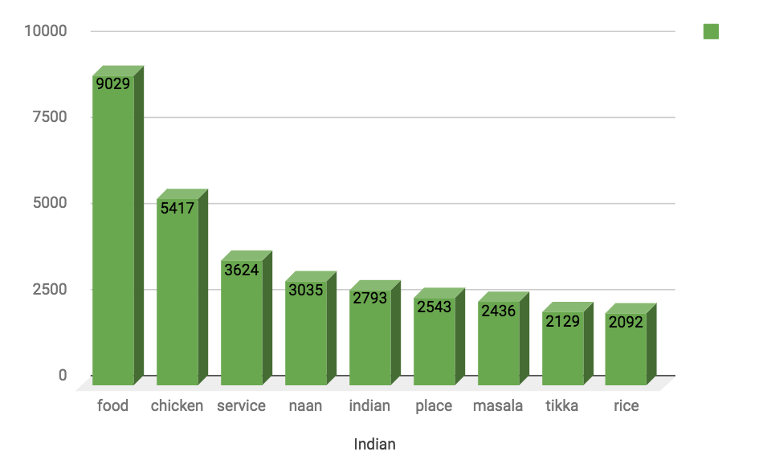
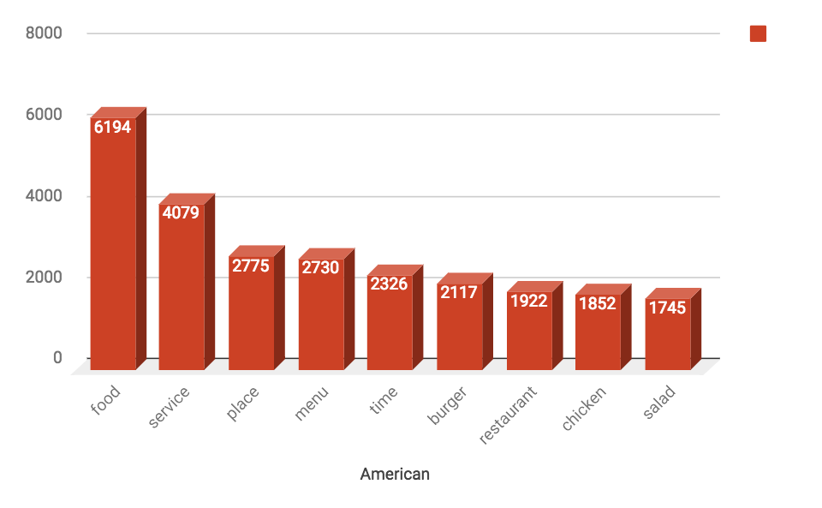
Analysis and Conclusions
Top three attributes: (Indian)
Food
Chicken
Service
Top specific concern:
Naan
Masala
Tikka
Rice
Top three attributes: (American)
Food
Service
Place
Top specific concern:
Burger
Chicken
Salad

Slide 10
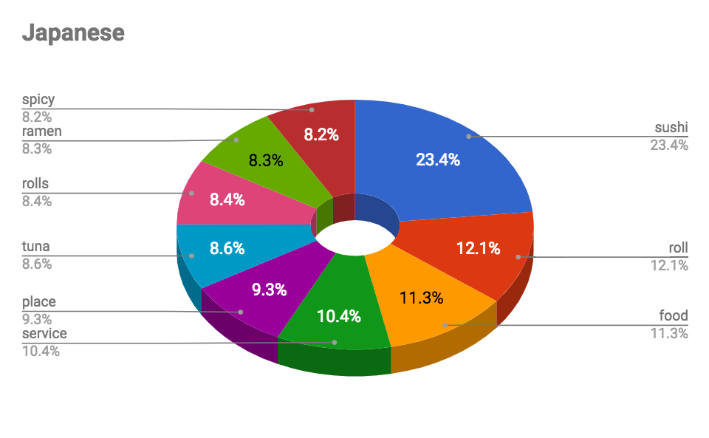
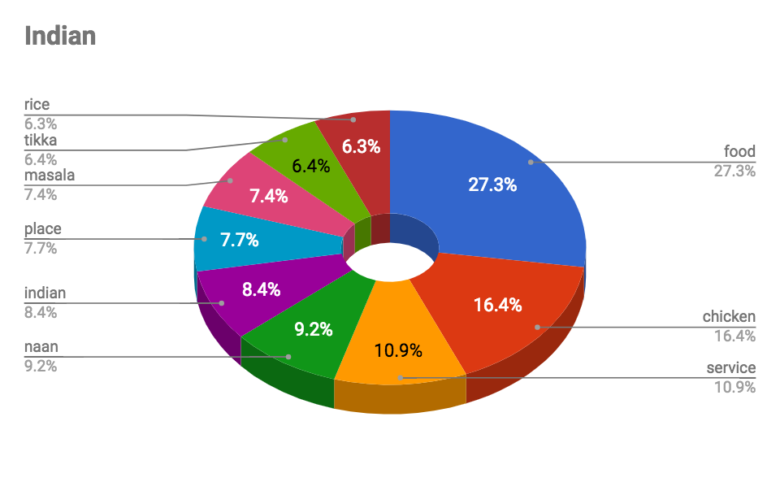
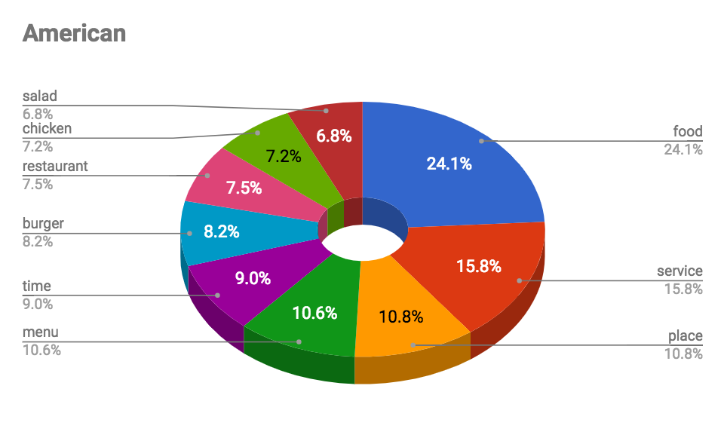
Analysis and Conclusions
Pie Chart Analysis
(Top 9 attributes of three types of restaurants)

Slide 11
Analysis and Conclusions
Conclusions
The similarity
The customers of these three kinds of restaurants are concerned about the “food” at most.
The “service” is the second attributes that the customers consider about.
The third attribute that customers think is important is “place”.
Analysis
Most customers will consider about the food and the service of the restaurant, they would like to use these two standard to evaluate whether a restaurant is good or not.
The location or the environment which are related to “place” should also be a important factor of how customer evaluate a restaurant.

Slide 12
Analysis and Conclusions
Conclusions
The Difference
For Indian restaurant, the keyword of food are chicken, naan, masala, tikka and rice. It means that the mostly customers’ taste and their order are chicken, naan, masala, tikka and rice.
For Japanese restaurant, the keyword of food are Sushi, roll, tuna, ramen and spicy. It indicates that mostly customers order Sushi, roll, tuna, ramen and some spicy food.
For American restaurant, the keyword of food are burger, chicken and salad. It shows that customers like burgers, chicken and salad mostly.
Analysis
When evaluating a restaurant, customer will choose the taste of typical dishes as an attribution of it. The traditional taste should be an important factor for customers to decide whether a restaurant provide good products or not.
For example, if Japanese restaurant is able to provides tasty sushi, Indian one provides nice naan or American one has burger, these restaurant will be more attractive than others that could not provide.

Slide 13
Future development/improvements
Using the POS tagger from nltk, we realized that there are many words that might have different roles in the sentence and in most of the cases were tagged as nouns, e.g. awesome, cozy, amazing.etc. Had we have more time we would have investigated ways to customize the ntlk POS tagging to match better our needs.
There were many “compound words”, such as “rice bowl” or “chicken dish” that we captured as two separate attributes. In the future further investigation would be needed as how to capture these as a whole combo.
Finally, the analysis of attributes could be improved over the time by creating a Lexicon of established common words for each restaurant type.

Slide 14
Project Repository
Github:https://github.com/jackyli0318/yelp_scraper

